Slide 1
SYSTEMS
ANALYSIS AND DESIGN
Nguyen Thanh Binh, Nguyen Quang Vu, Le Viet Truong, Nguyen Thi Hanh, Vo Van Luong, Le Thi Bich Tra
Faculty of Computer Science

Slide 2
Case study

Slide 3

Case study
Problem
  A very simple problem to show the use of UML in analysis and design
  It is taken from the “Applying UML and Patterns” book of Claig Larman
  A dice game
    The player rolls 10 times 2 dice. If the total of two dice is 7, he gains 10 points. At the end of the game, the score is saved to the scoreboard

Slide 4
Main Activities of Software Development
Requirements Gathering
Define requirement specification
Analysis
Define the conceptual model
Design
Design the solution / software plan
Implementation
Code the system based on the design
Integration and Test
Prove that the system meets the requirements
Deployment
Installation and training
Maintenance
Post-install review
Support docs
Active support

Slide 5
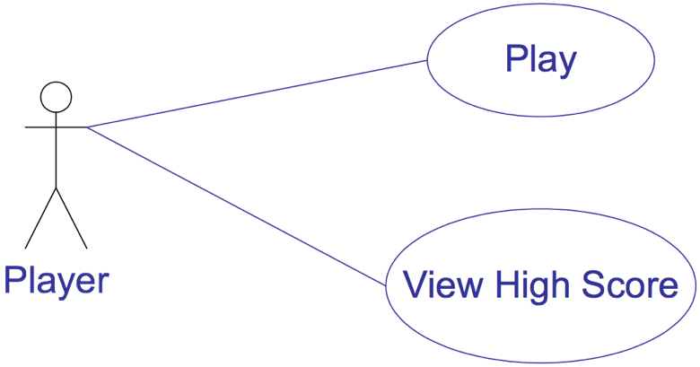
Case study
Requirement analysis
  Use-case diagram
  Use-case: Play
    Description: The player rolls 2 dice 10 times. If each time the total is 7, he receives 10 points.
  Use-case: View High Score
    Description: They player consults the scores

Slide 6
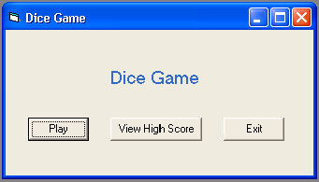
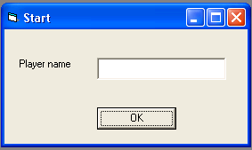
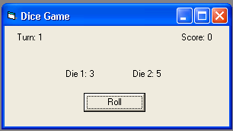
Case study
Requirement analysis
  Activity diagram
    Some activities are linked to the graphical user interface
[
view
]
[
play
]
[
exit
]
View High Score
Play
Roll dice
[
true
]
Turn
<
10
[
false
]
Update High Score

Slide 7
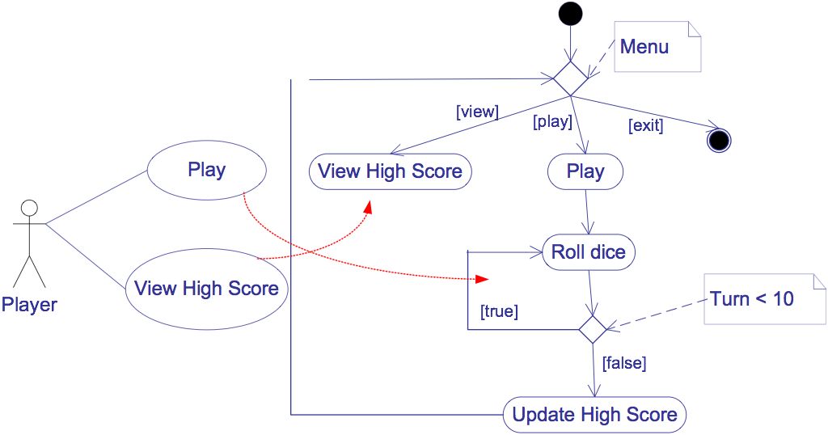
Use-case
Requirement analysis
  Activity diagram
    The relationship between the use-case diagram and activity diagram

Slide 8
Main Activities of Software Development
Requirements Gathering
Define requirement specification
Analysis
Define the conceptual model
Design
Design the solution / software plan
Implementation
Code the system based on the design
Integration and Test
Prove that the system meets the requirements
Deployment
Installation and training
Maintenance
Post-install review
Support docs
Active support

Slide 9
Case study
Analysis
  Modelling the real world
  Independent of the implementation
  Modelling of the domain: conceptual class diagram
  Modelling of the dynamic behaviour of the system: collaboration diagram

Slide 10
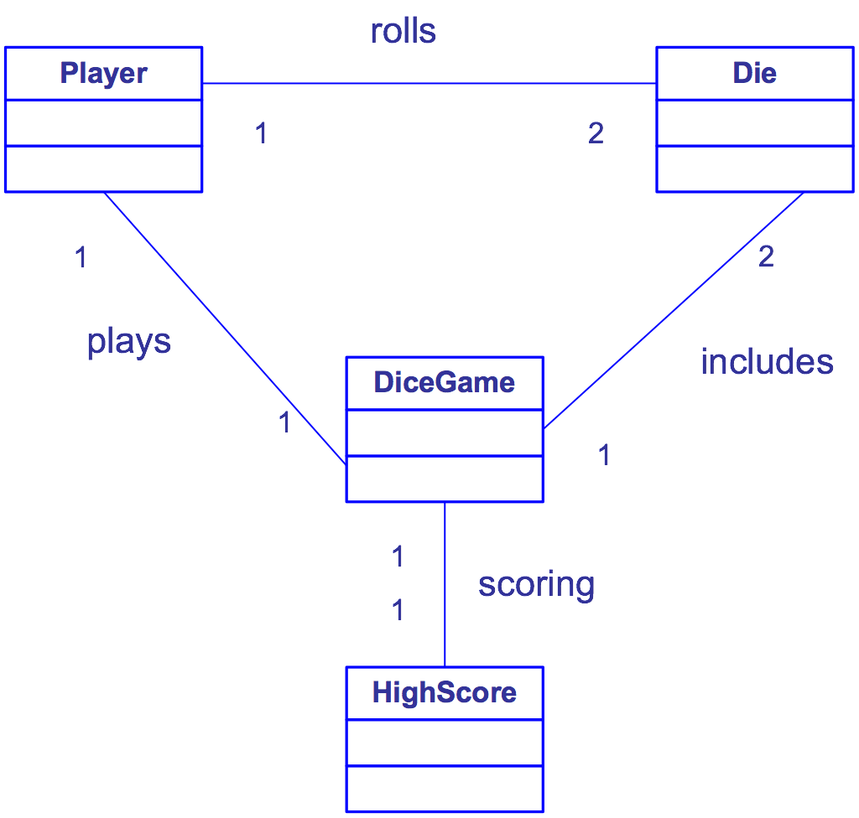
Case study
Modeling of conceptual class diagram

Slide 11
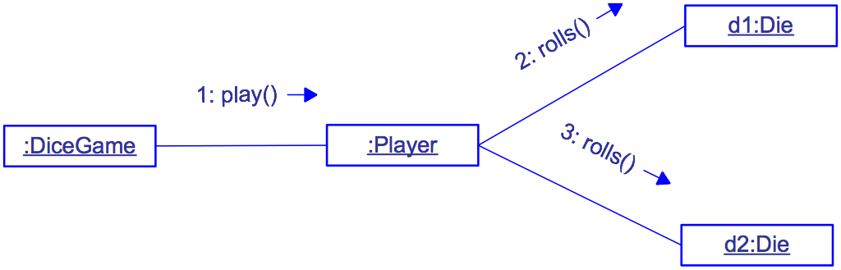
Case study
A first collaboration diagram

Slide 12
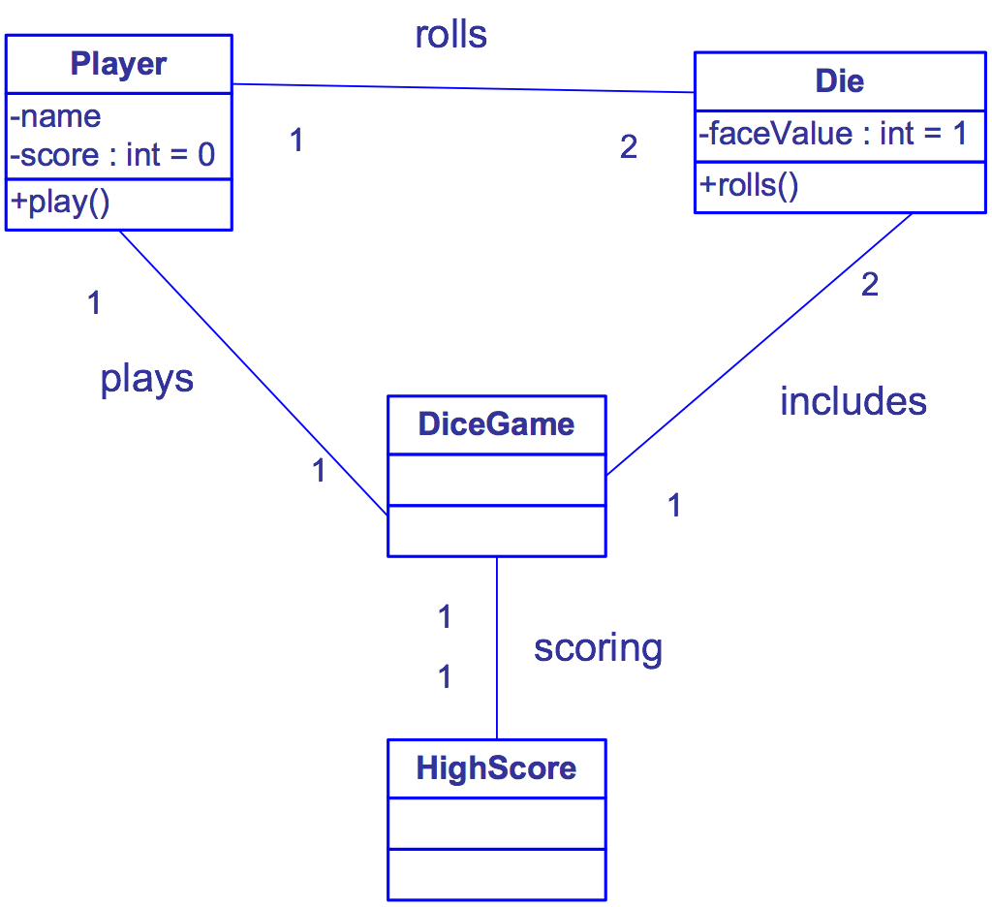
Case study
A first class diagram

Slide 13
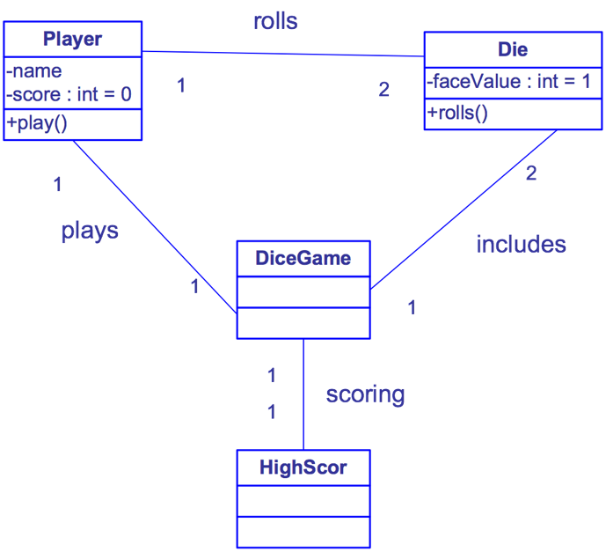
Case study
Collaboration diagram and class diagram

Slide 14
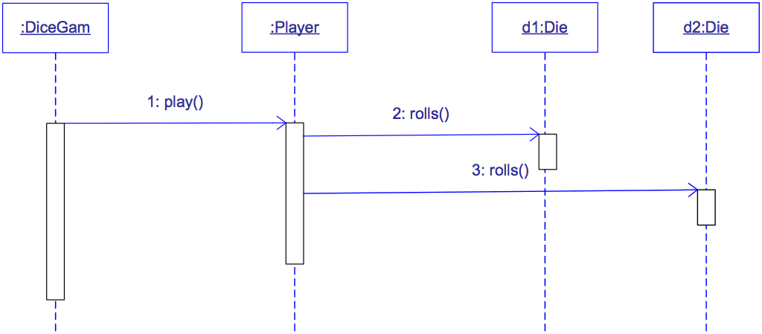
Case study
Sequence diagram

Slide 15
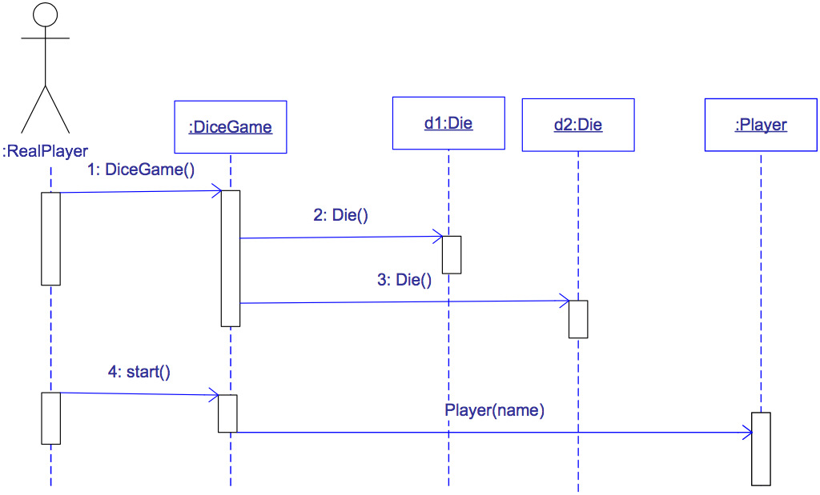
Case study
The creation of objects at the beginning of the game (DiceGame) for a player

Slide 16
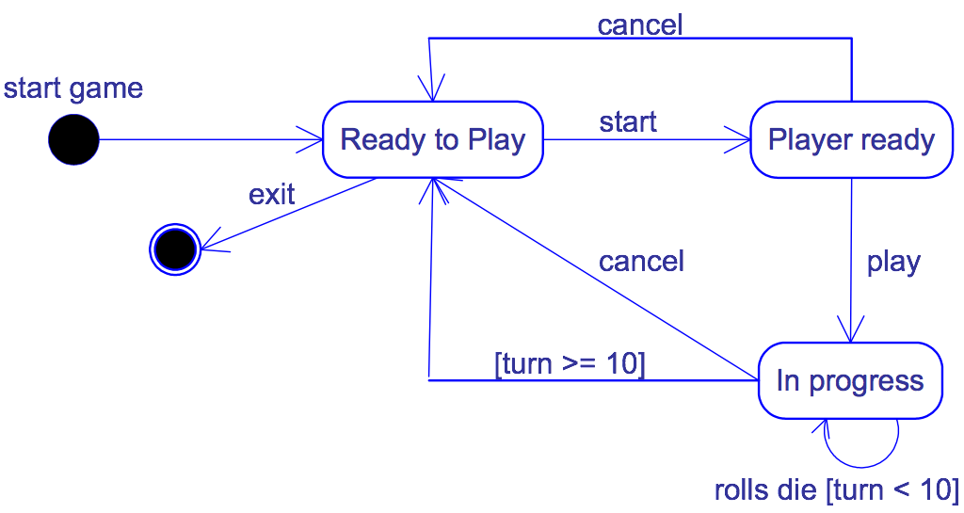
Case study
State diagram: modelling the states of the DiceGame

Slide 17
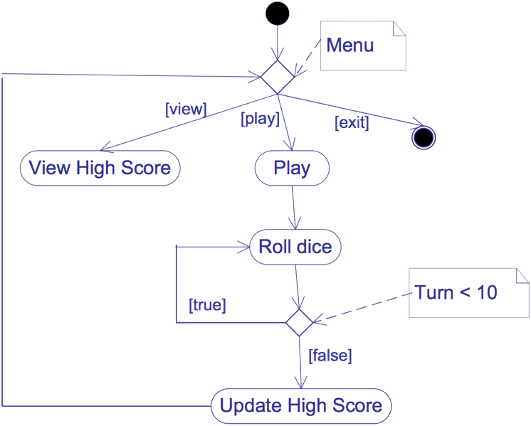
Case study
Detection of inconsistency between the activity diagram and the state diagram

Slide 18
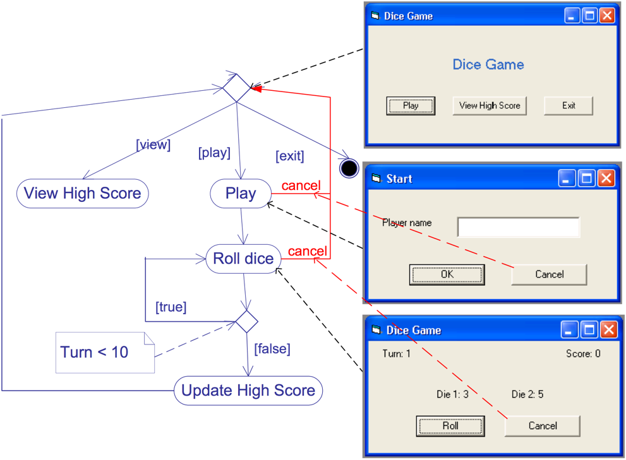
Case study
Modification of the activity diagram as well as the envisaged graphical user interface

Slide 19
Case study
The treatment of the scoreboard must be taken into account: the update and the creation
No treatment

Slide 20
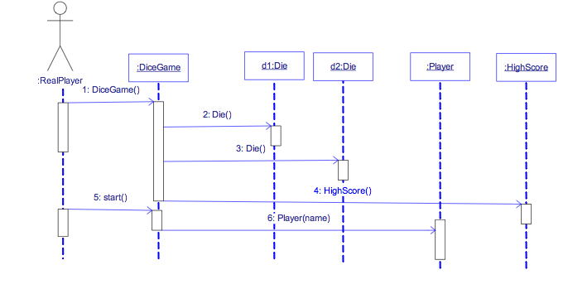
Case study
Sequence diagram: manage high score, create new player

Slide 21
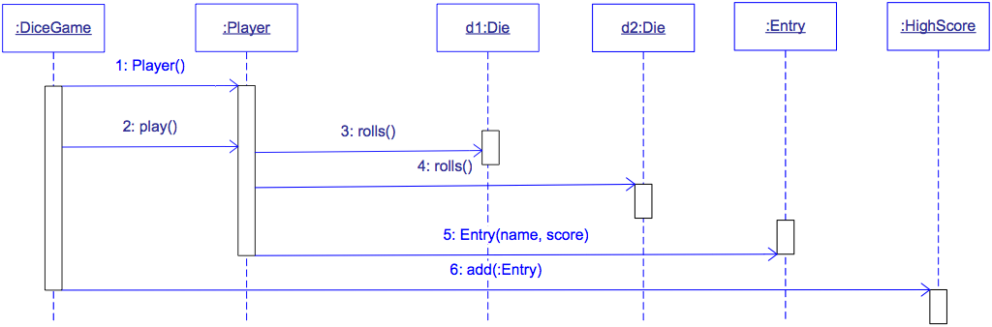
Case study
Sequence diagram: add high score to score board

Slide 22
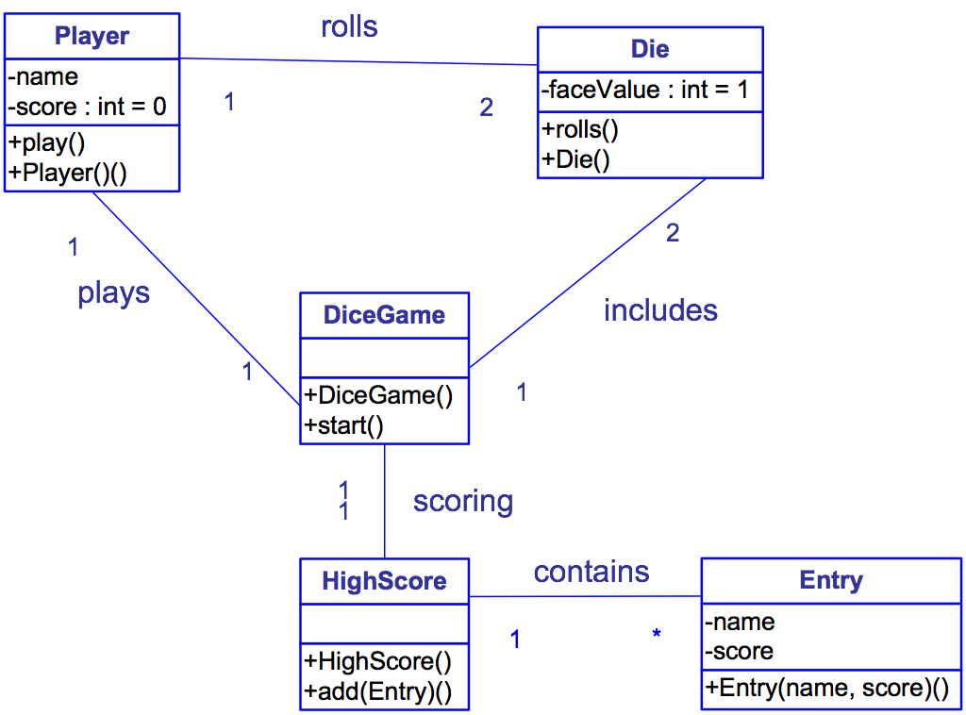
Case study
Class diagram

Slide 23
Main Activities of Software Development
Requirements Gathering
Define requirement specification
Analysis
Define the conceptual model
Design
Design the solution / software plan
Implementation
Code the system based on the design
Integration and Test
Prove that the system meets the requirements
Deployment
Installation and training
Maintenance
Post-install review
Support docs
Active support

Slide 24
Case study
Design
  Take into account the implementation
    Manage the graphical user interface part
    Manage the persistence of scoreboard
  Define the logical architecture
  Define the physical architecture
  Introduce the technical class permitting to implement the architecture

Slide 25
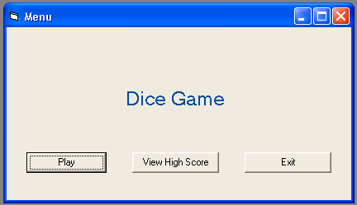


Case study
General architecture
  Classical three layer architecture
Presentation
Business Logic
Persistence

Slide 26
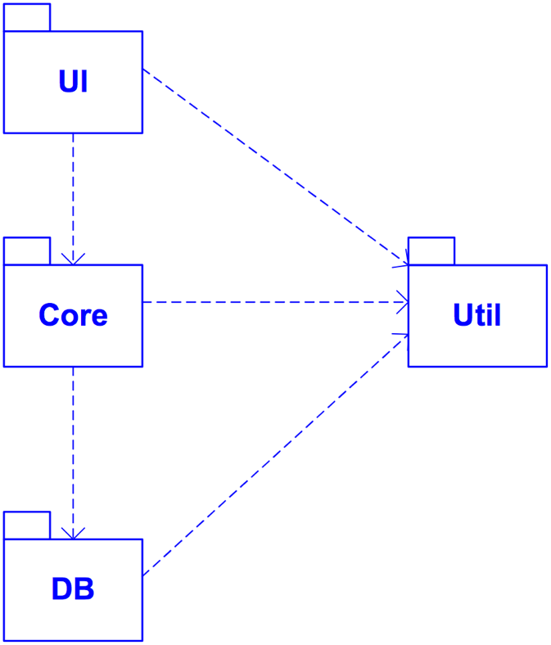
Case study
A package diagram corresponds to the architecture
UI : presentation layer
Core : Business logic layer
DB : Persistence layer
Util : utility services/classes/functionalities

Slide 27
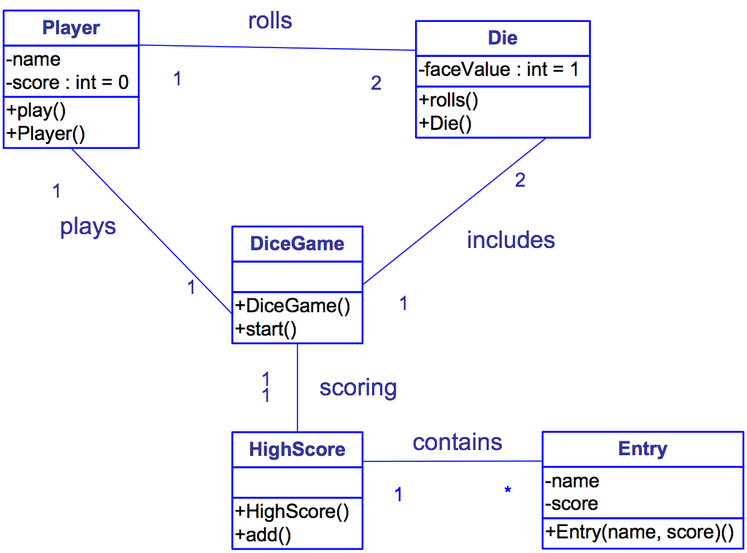
Case study
Use design patterns to improve the classes of “Core” package
Class DiceGame has only one object
Class HighScore has only one object
Design pattern : Singleton

Slide 28
Case study
Singleton design pattern
  Application to DiceGame and HighScore.
Singleton
static uniqueSingleton
other attributs …
static instance()
other operations …
return uniqueSingleton;

Slide 29
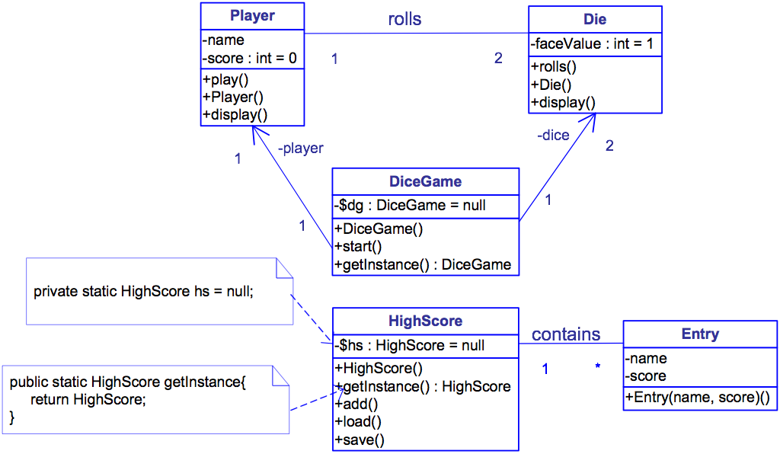
Case study
Modified class diagram

Slide 30
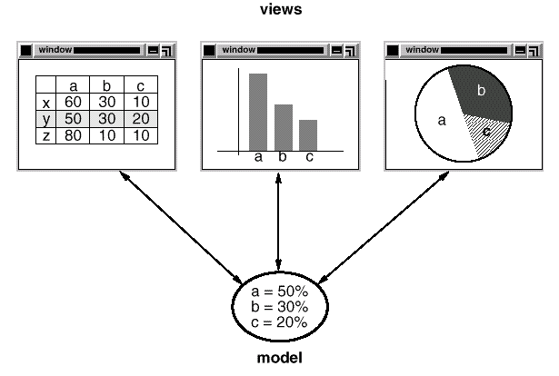
Case study
Observer design pattern
Subject
attach(o Observer)
dettach(o Observer)
notify()
observer
Observer
update()
for all o in observer
o.update()
ConcreteSubject
getState()
setState()
subjectState
subject
ConcreteObserver
update()
observerState
return subjectState;
observerState=
subject.getState()

Slide 31
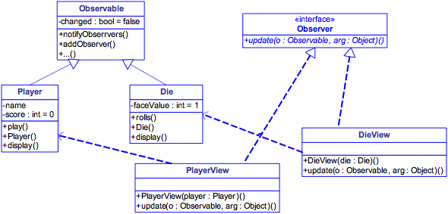
Case study
Application of Observer design pattern to improve the class diagram
  Decouple the graphical views and objects for the dice and players
  Application of Observer pattern
    Die and Player classes are ConcreteSubject class
    Introduce DieView et PlayerView as ConcreteObserver classes

Slide 32
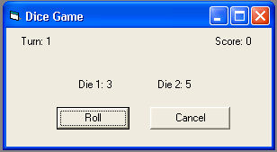
Case study
User view are instances of javax.swing.JPanel.java
Observable
«interface»
-
changed
:
bool
=
false
Observer
+
notifyObserrvers
()
+
update
(
o
:
Observable
,
arg
:
Object
)()
+
addObserver
()
+...()
JPanel
Player
Die
-
name
-
faceValue
:
int
=
1
-
score
:
int
=
0
+
rolls
()
+
play
()
+
Die
()
DieView
+
Player
()
+
display
()
+
display
()
PlayerView
+
DieView
(
die
:
Die
)()
+
update
(
o
:
Observable
,
arg
:
Object
)()
+
PlayerView
(
player
:
Player
)()
+
update
(
o
:
Observable
,
arg
:
Object
)()

Slide 33
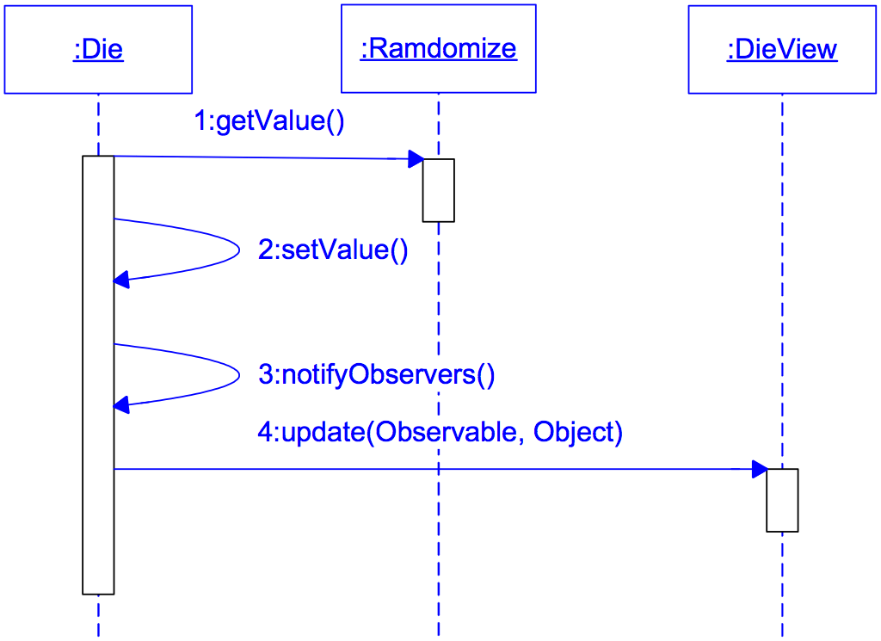
Case study
Sequence diagram describes the interactions between Die object the its view

Slide 34
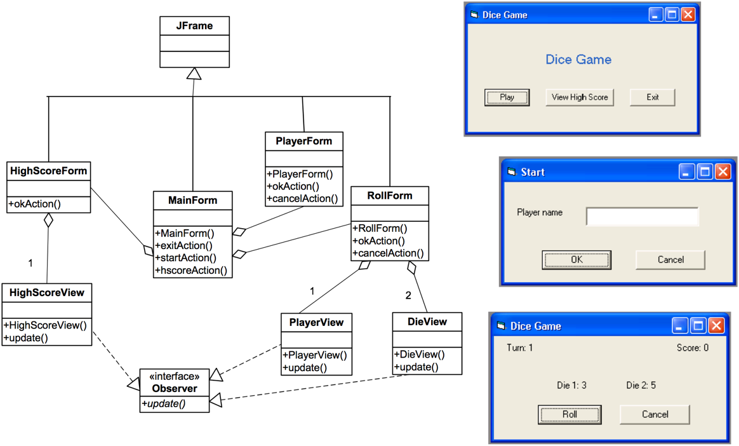
Case study
The design of “UI” package

Slide 35
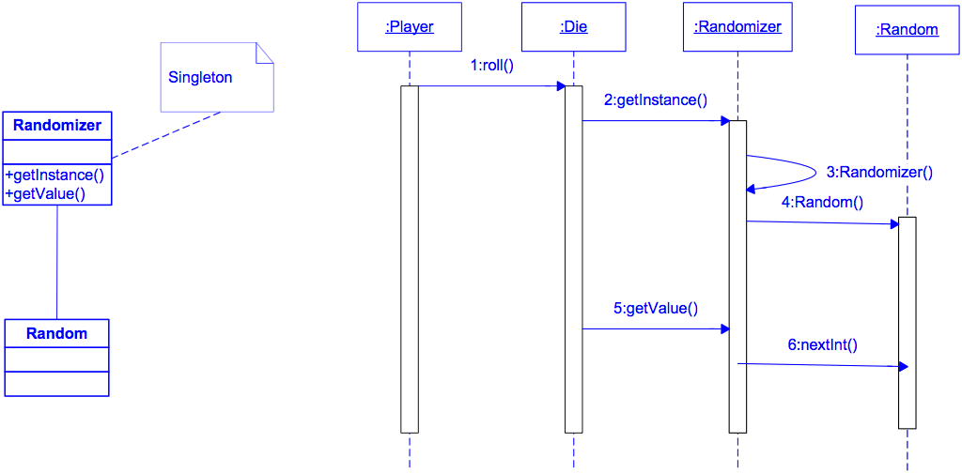
Case study
The design of “Util” package

Slide 36
Case study
The design of “DB” package
  How to ensure the independence between “Core” and “DB” package
    In order to be able to use several persistence types
      File (serialisation)
      Relation Database Management System (via JDBC)
    Use FactoryMethod design pattern
…
product = factoryMethod();
…
Creator
factoryMethod()
anOperation()
Product
*
1
ConcreteProduct
CreateCreator
factoryMethod()
return new ConcreteProduct();
<<create>>

Slide 37
Case study
The design of “DB” package
  Class diagram
HighScore
DBKit
-
$
hs
:
HighScore
=
null
-
:
+
HighScore
()
+
makeKit
()
+
getInstance
() :
HighScore
+
add
()
+
load
()
+
save
()
FileKit
JDBCKit
HighScoreJDBC
HighScoreFile
+
makeKit
()
+
makeKit
()
+
HighScoreJDBC
()
+
HighScoreFile
()
+
load
()
+
load
()
+
save
()
+
save
()
<<
create
>>
Note : HighScore class is a Singleton

Slide 38
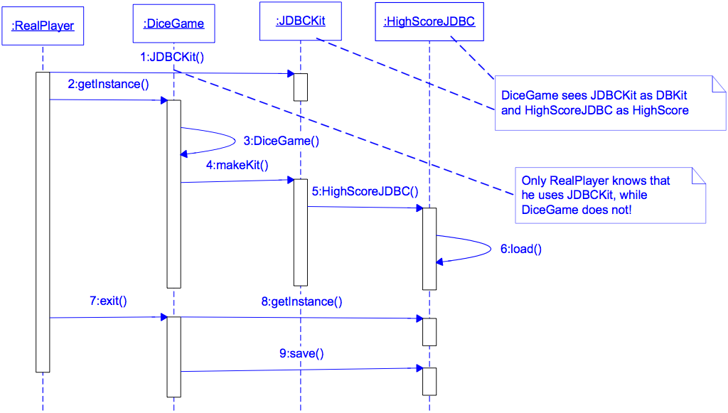
Case study
The design of the “DB” package
  Sequence diagram

Slide 39
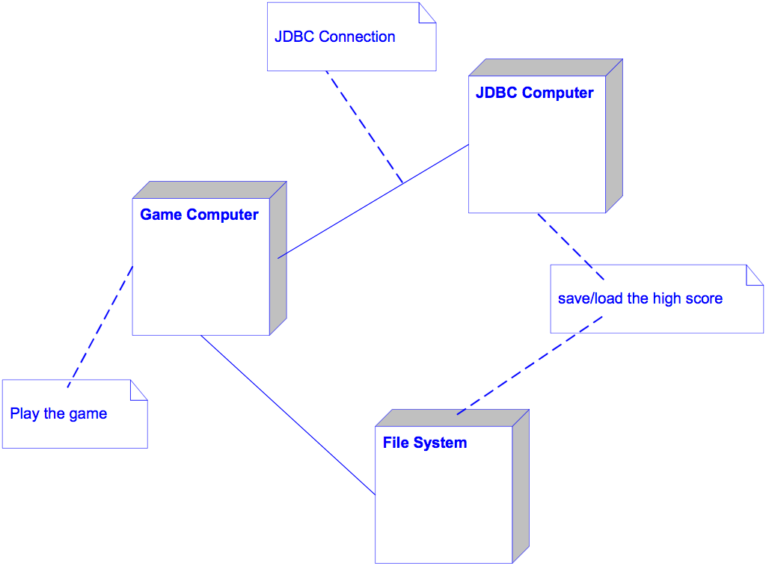
Case study
Deployment diagram

Slide 40
Main Activities of Software Development
Requirements Gathering
Define requirement specification
Analysis
Define the conceptual model
Design
Design the solution / software plan
Implementation
Code the system based on the design
Integration and Test
Prove that the system meets the requirements
Deployment
Installation and training
Maintenance
Post-install review
Support docs
Active support

Slide 41
Case study
Complete the interaction diagrams
Generate the code

Slide 42
Conclusions

Slide 43
Conclusions
Distinction between functional approach and object-oriented approach
Master the basic object-oriented concepts
UML: a modelling language
  Need a development process
  Different views
  Different models
  Use of the models in different development activities
Master the main diagrams
  Use-case diagram
  Class diagram
  Interaction diagram

Slide 44
Conclusions
The UML concepts can be extended
  The extensions
Transformation of models to code
  Models independent of programming language
The automatic code generation is only a supplement
  The models guide the coding process
Master design principles
  GRAPS principles/patterns
  Some design patterns

